Slide 1
Keylogger
Presented by:
D.Partha Sarathy – B.Tech (AI & DS)
Sri Muthukumaran Institute of Technology

Slide 2
Outline
Problem Statement
Proposed System/Solution
System Development Approach
Algorithm & Deployment
Result
Conclusion
Future Scope
References

Slide 3
Problem Statement
In today's digital age, where cybersecurity threats loom large, one of the significant concerns is the proliferation of keyloggers, stealthy software tools designed to monitor and record keystrokes on a user's computer without their knowledge. Keyloggers pose a severe threat to individuals and organizations as they can capture sensitive information such as passwords, credit card details, and other personal data, leading to identity theft, financial loss, and privacy breaches.

Slide 4
Proposed Solution
The proposed solution involves a Python script that utilizes the pynput library to log keyboard events and Tkinter for GUI. The keylogging is triggered by a button click on the GUI and captures keystrokes, storing them in both a text and JSON file with timestamps. This streamlined approach focuses solely on the core functionality of the keylogger, making it more concise and straightforward.

Slide 5
System Development Approach
System Requirements:
Operating System: Windows 7 or later / macOS X 10.9 or later / Linux with GTK 3 or later
Python Version: Python 3.6 or later
Minimum RAM: 2 GB
Minimum Storage: 100 MB available disk space
Libraries Required:
pynput: This library will be used to monitor keyboard events and capture keystrokes.
time: The 'time' library will be required to generate timestamps for each keystroke entry, ensuring accurate logging of events.
Tkinter: Tkinter will be utilized to develop the graphical user interface for the keylogger application.
json: This library will be used to handle the JSON file format and store captured keystrokes in a structured manner.

Slide 6
Algorithm & Deployment
Algorithm:
1. Import necessary modules and libraries.
2. Define constants and variables, such as WIDTH, HEIGHT, L_LIMIT.
3. Define apply_keylogger function to handle keylogging functionality, with key press & release look up table and on_press and on_release handling functions that shares the look up table.
4. Create a tkinter window and configure it.
5. Set up UI elements (background, labels, button).
6. Call apply_keylogger which applies the keylogger functionalities to the UI and return on_close handler function.
7. Manage window close event by using the on_close handler.
8. Start the tkinter in try block in except block call the on_close function which ensures the app safely closed in the event of crash.
Deployment:
- Package the Application: Use a tool like PyInstaller to package the Python script into an executable.
- Shell script: Using a shell script we can install required python interpreter version and create a virtual environment with required packages and run the 'keylogger.py' script as a process automatically.
- After using any one of these options we can be able to successfully run the program in any targeted system.

Slide 7
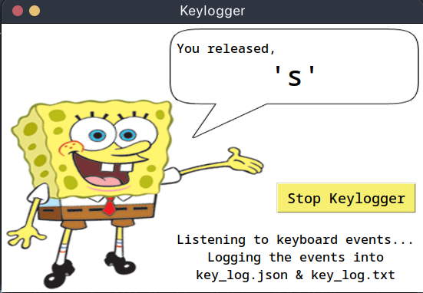
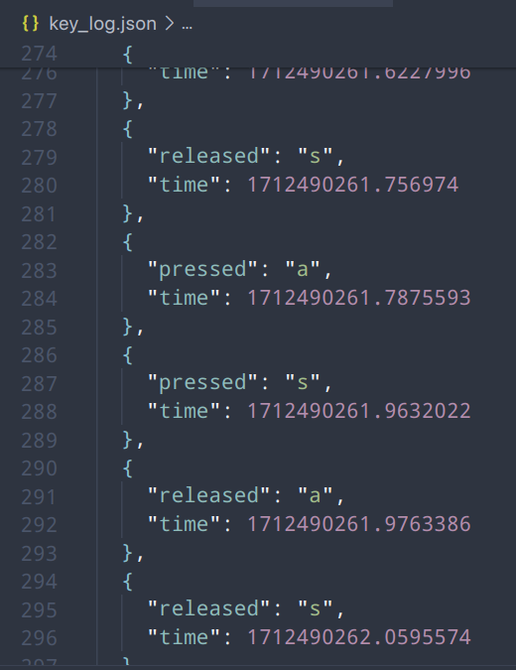
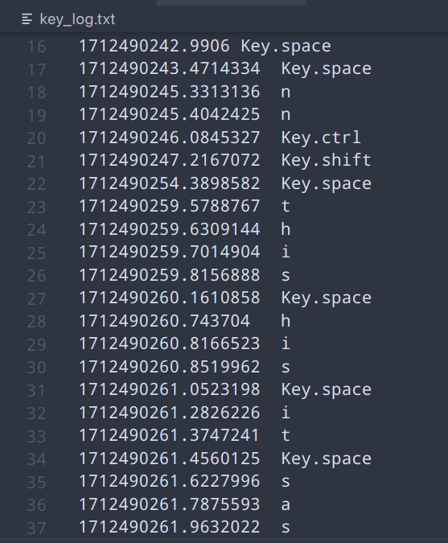
Result

Slide 8
Conclusion
This project showcases a minimalist keylogger built in Python, leveraging tkinter for the user interface and pynput for keyboard event management. Users can initiate and terminate keylogging sessions via a button, with real-time updates on key presses and releases. The logged data is stored in both JSON and text files. This project effectively demonstrates the integration of GUI elements with keyboard event tracking, offering a straightforward yet functional keylogging solution.

Slide 9
Future Scope
Future enhancements for this Keylogger:
- Integrate log file compression to optimize storage space.
- Implement a feature to periodically send compressed log files to an anonymous email address when internet connection is available.
- Enhance security by incorporating encryption techniques to protect data privacy during transmission.
- Improve the user interface for better usability and intuitive interaction.
- Implement robust error handling mechanisms to gracefully manage unexpected scenarios.
- Add functionality to detect and handle network connectivity issues effectively.
These enhancements would elevate the application's utility, security, and reliability, making it a more valuable tool for users.

Slide 10
References
Tkinter documentation: https://docs.python.org/3/library/tkinter.html
Pynput documentation: https://pynput.readthedocs.io/en/latest/
Keystroke logging: https://en.wikipedia.org/wiki/Keystroke_logging
Keylogger definition: https://www.techopedia.com/definition/4000/keylogger

Slide 11
Thank You

